Slide 1
The Other Cloud for .NET Developing with .NET 7 on AWS
Chris Woodruff

Slide 2

Chris Woodruff
cwoodruff@live.com
@cwoodruff
http://woodruff.dev

Slide 3

What do you need to start using AWS?

Slide 4

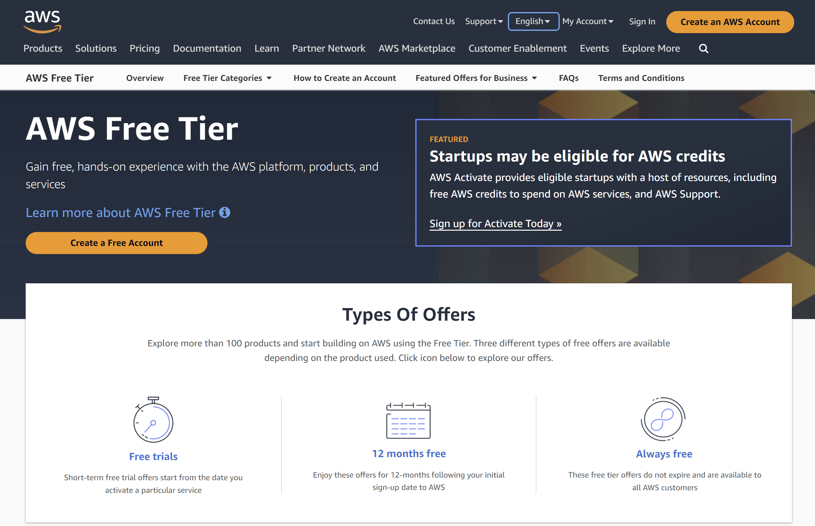
Sign up for an AWS Account

Slide 5
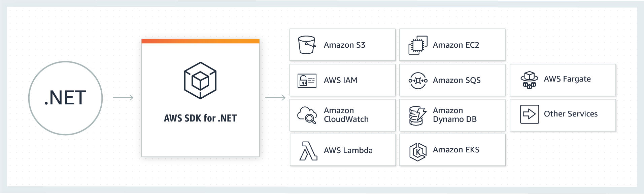
AWS SDK for .NET

Slide 6
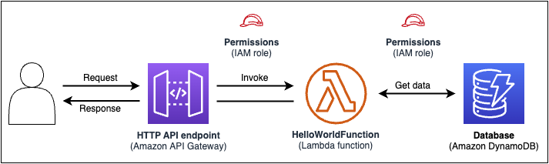
AWS Serverless Application Model (AWS SAM)
AWS SAM command line interface

Slide 7
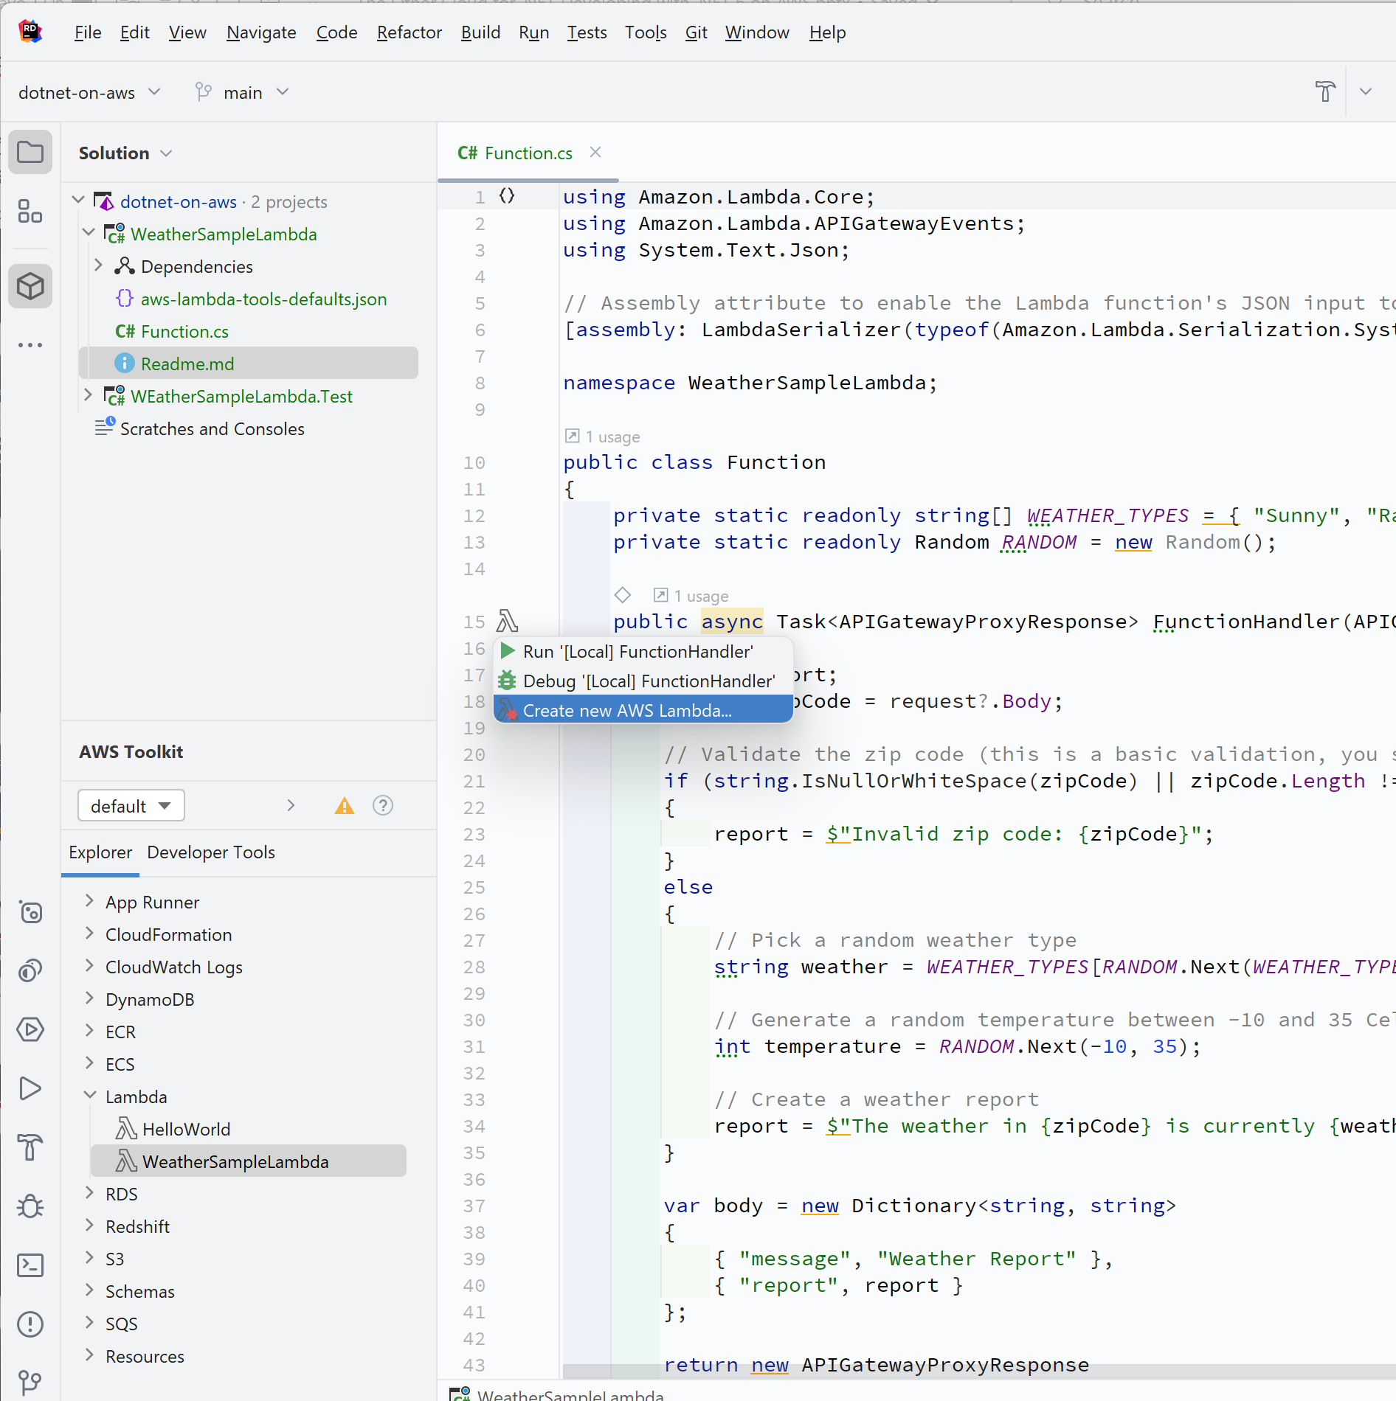
AWS Toolkit for your IDE
Visual Studio
JetBrains Rider
Visual Studio Code

Slide 8
AWS CodeCatalyst

Slide 9
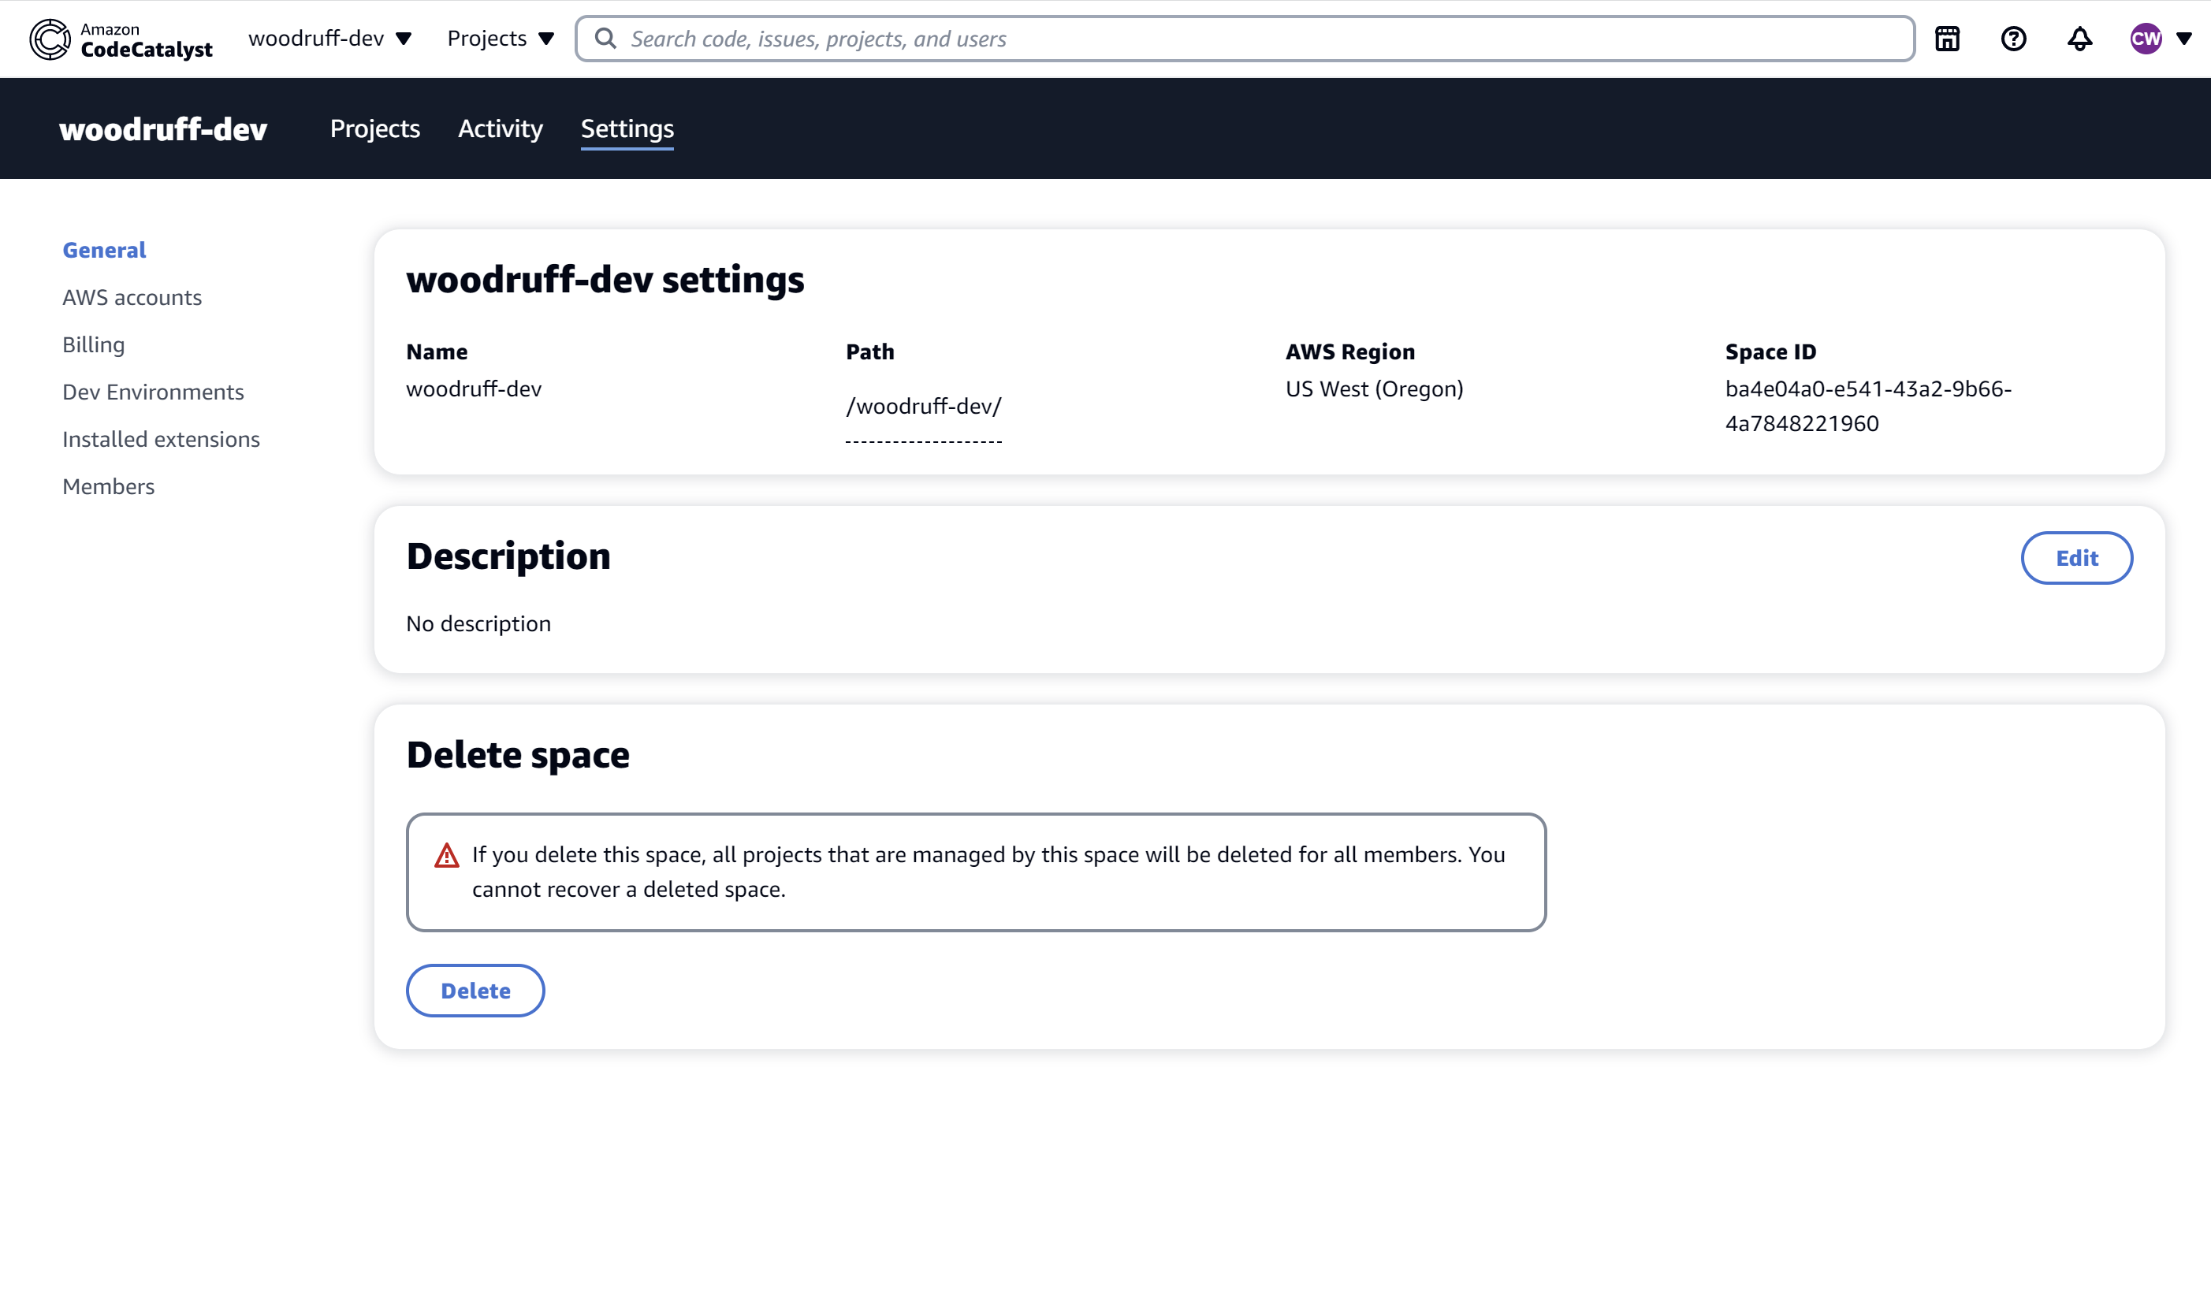
CodeCatalyst Space

Slide 10
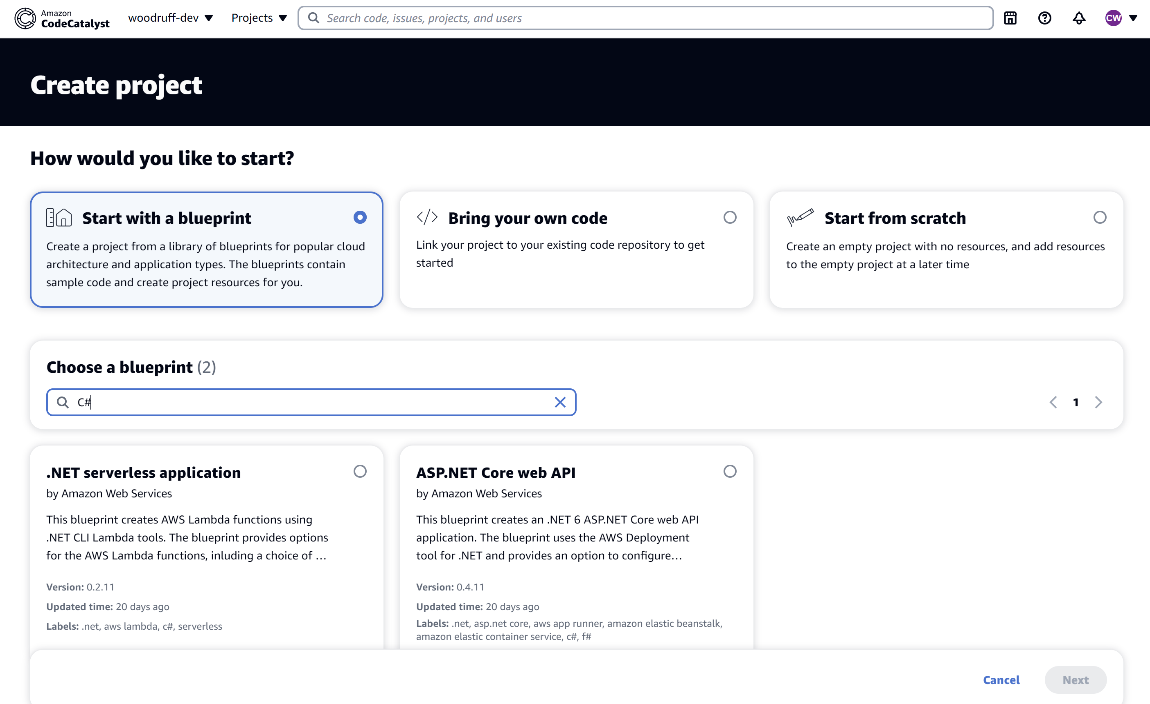
CodeCatalyst Project

Slide 11
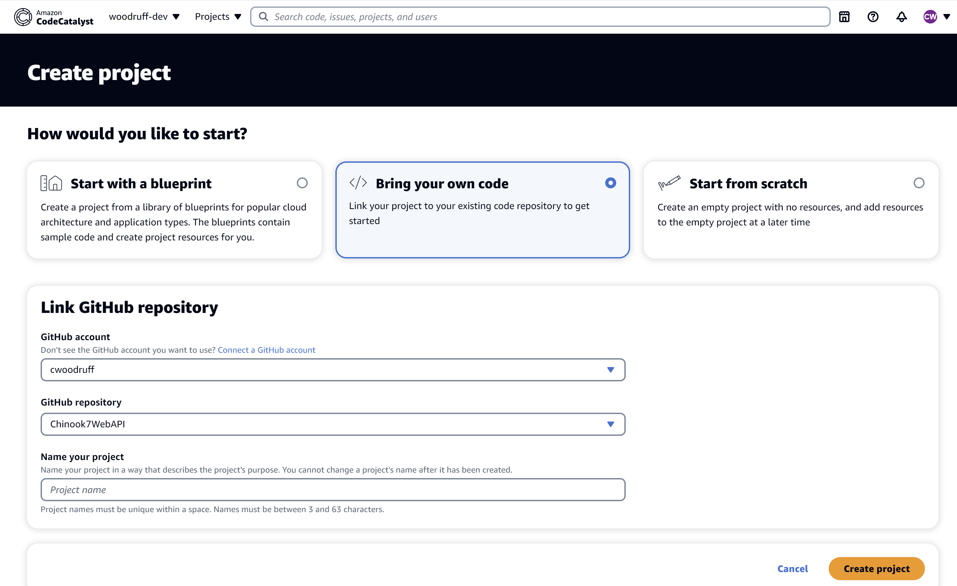
CodeCatalyst Project

Slide 12
Amazon RDS

Slide 13
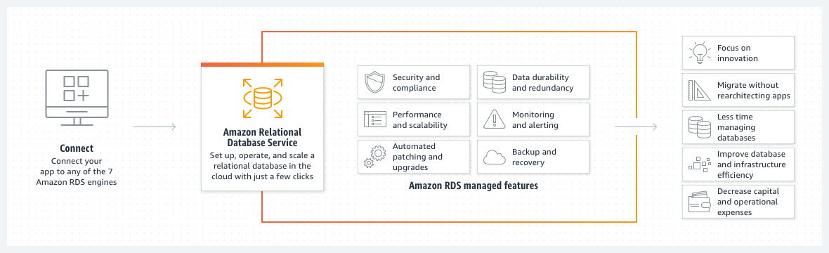
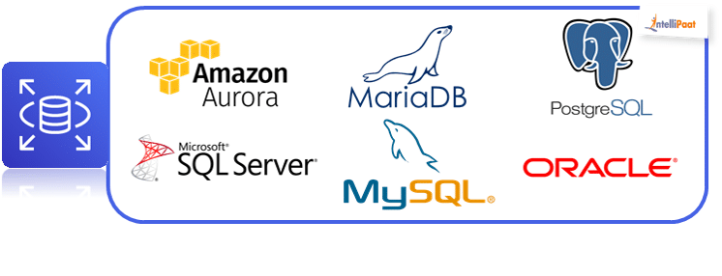
Amazon RDS

Slide 14
Amazon DynamoDB

Slide 15
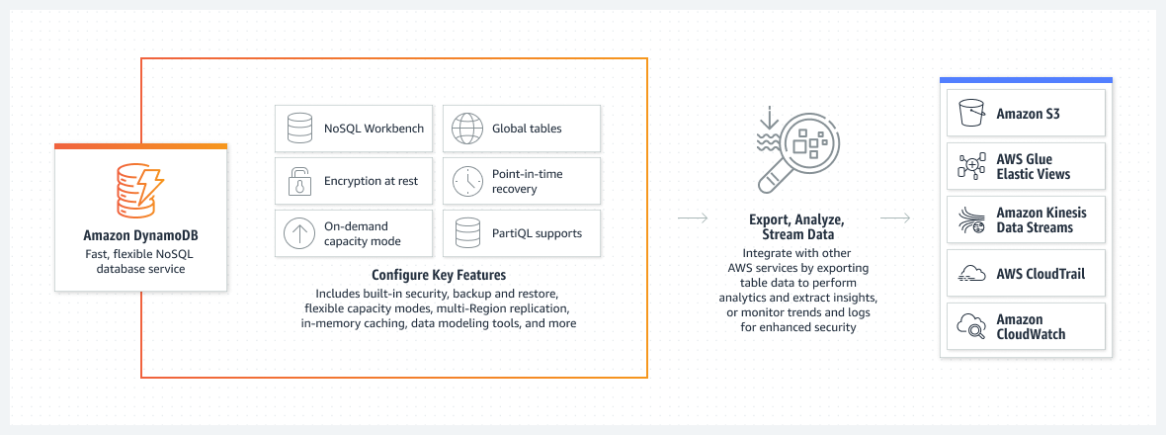
Amazon DynamoDB

Slide 16

AWS CloudWhisperer

Slide 17
AWS Lambda

Slide 18


Slide 19
Deploying Lambda using DotNet CLI
dotnet lambda deploy-function WeatherSampleLambda --function-role user

Slide 20
AWS Microservice Extractor for .NET

Slide 21
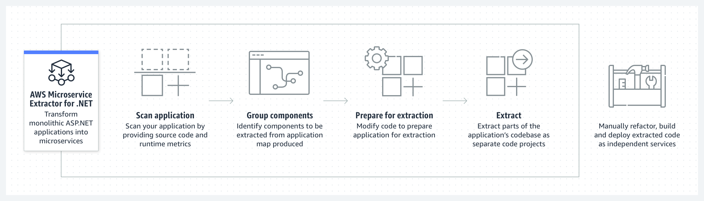
AWS Microservice Extractor for .NET

Slide 22
AWS Identity and Access Management

Slide 23
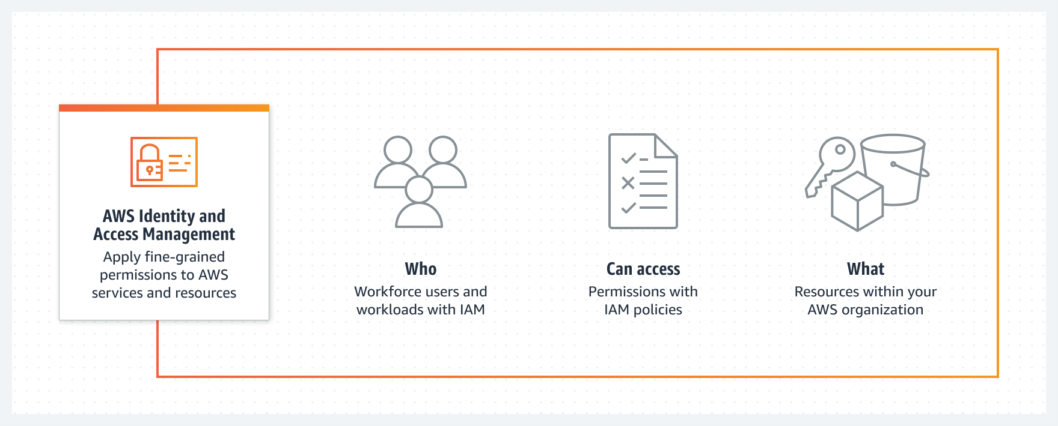
AWS Identity and Access Management

Slide 24
AWS Secrets Manager

Slide 25
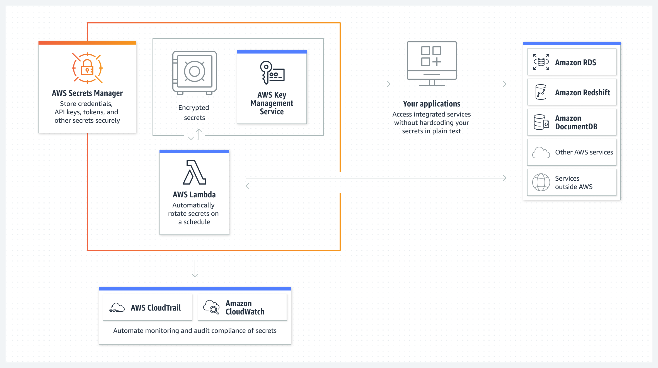
AWS Secrets Manager

Slide 26
public static string GetSecret() {
string secretName = "dev/myapp/config";
string region = "us-west-2";
string secret = "";
MemoryStream memoryStream = new MemoryStream();
IAmazonSecretsManager client = new AmazonSecretsManagerClient(RegionEndpoint.GetBySystemName(region));
GetSecretValueRequest request = new GetSecretValueRequest();
request.SecretId = secretName;
request.VersionStage = "AWSCURRENT"; // VersionStage defaults to AWSCURRENT if unspecified.
GetSecretValueResponse response = null;
try {
response = client.GetSecretValueAsync(request).Result;
}
catch (Exception e) {
throw;
}
if (response.SecretString != null) {
return secret = response.SecretString;
} else {
memoryStream = response.SecretBinary;
StreamReader reader = new StreamReader(memoryStream);
string decodedBinarySecret = System.Text.Encoding.UTF8.GetString(Convert.FromBase64String(reader.ReadToEnd()));
return decodedBinarySecret;
}
}

Slide 27
AWS CloudWatch

Slide 28
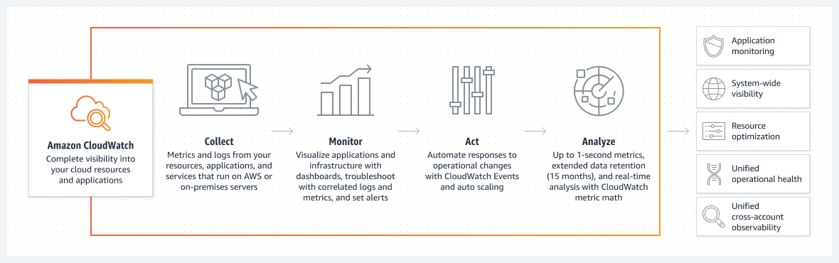
AWS CloudWatch

Slide 29
CloudWatch
How you can log data from C# to CloudWatch Logs
var awsAccessKeyId = "your access key";
var awsSecretAccessKey = "your secret access key";
var logGroupName = "your log group name";
var logStreamName = "your log stream name";
var client = new AmazonCloudWatchLogsClient(awsAccessKeyId, awsSecretAccessKey, RegionEndpoint.USWest2);
var request = new PutLogEventsRequest
{
LogGroupName = logGroupName,
LogStreamName = logStreamName,
LogEvents = new List<InputLogEvent>
{
new InputLogEvent
{
Message = "This is a test message",
Timestamp = DateTime.UtcNow
}
}
};

Slide 30
AWS Toolkit for .NET Refactoring

Slide 31
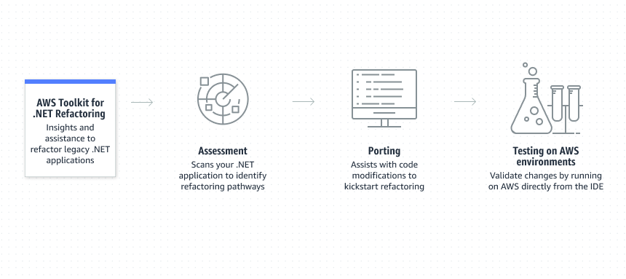
AWS Toolkit for .NET Refactoring

Slide 32

AWS CloudFormation

Slide 33
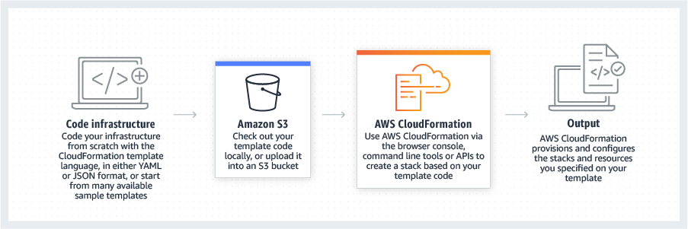
AWS CloudFormation
IaC (infrastructure as code)

Slide 34
AWS BeanStalk

Slide 35
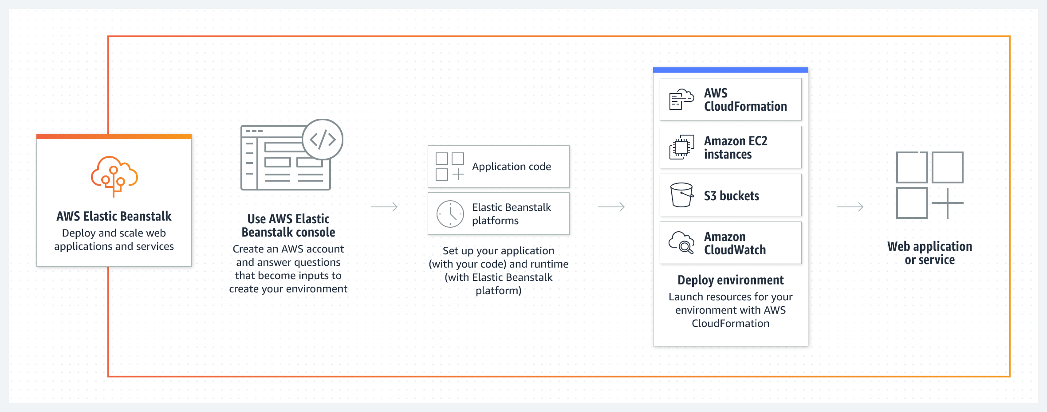
AWS BeanStalk
PaaS (platform as a service)

Slide 36
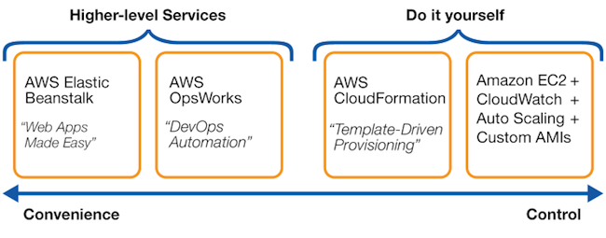
CloudFormation vs BeanStalk

Slide 37
AWS Load Balancing

Slide 38
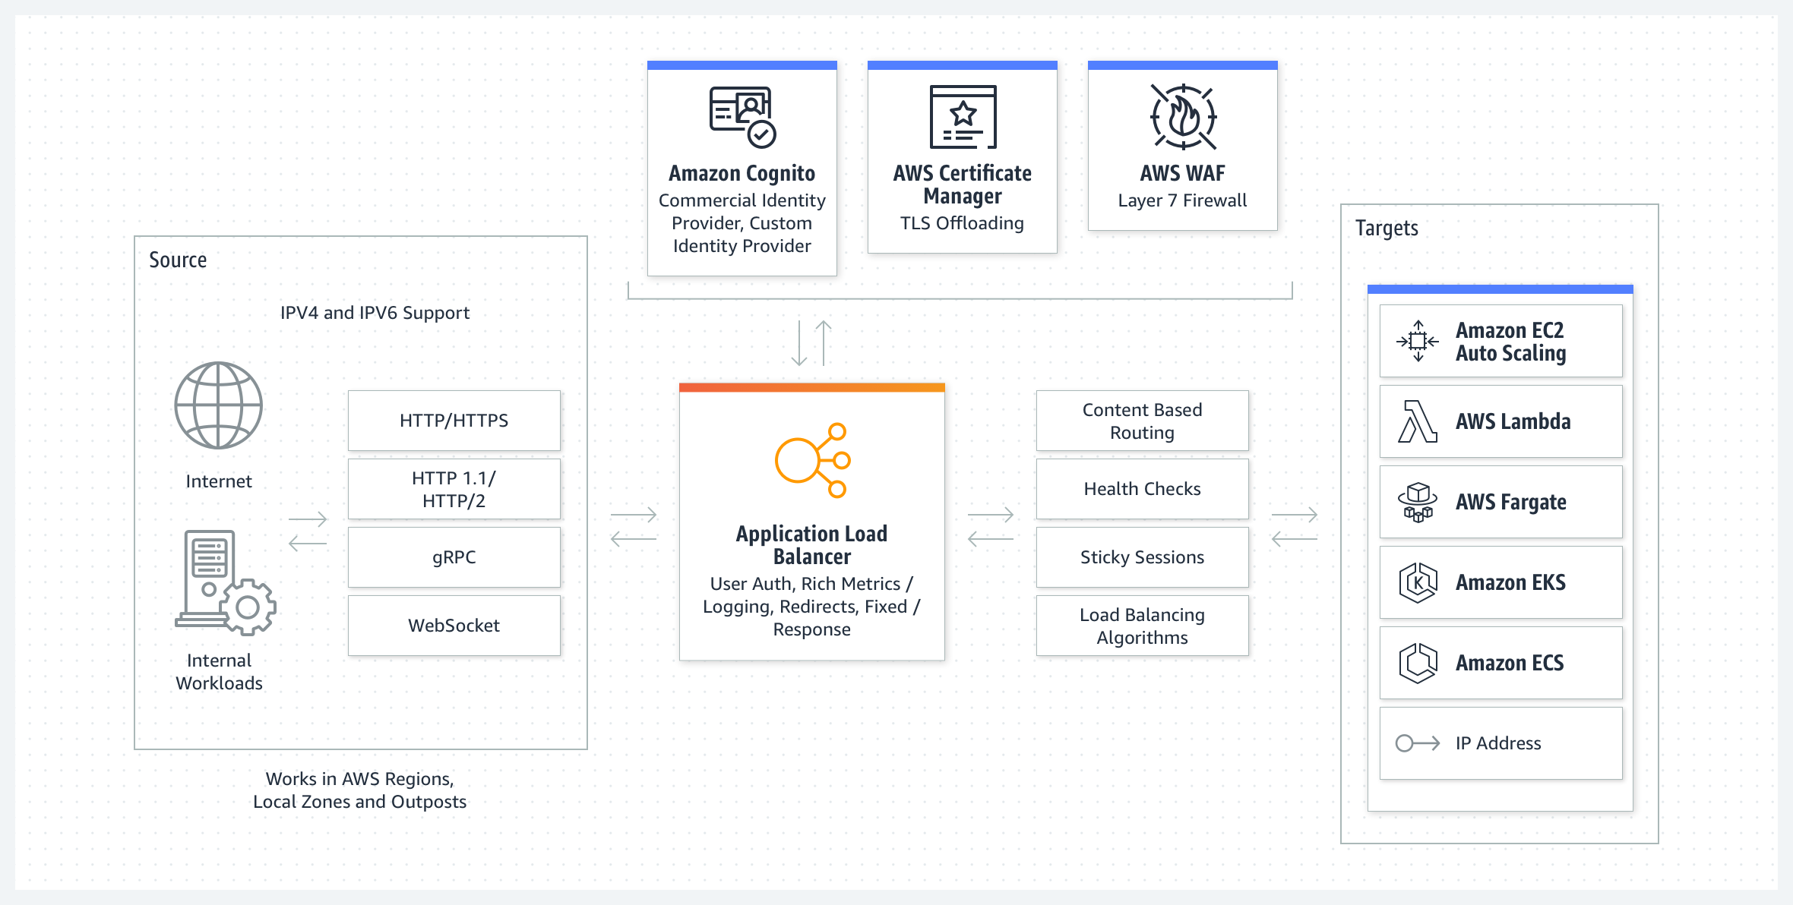
AWS Load Balancing

Slide 39
AWS App2Container

Slide 40
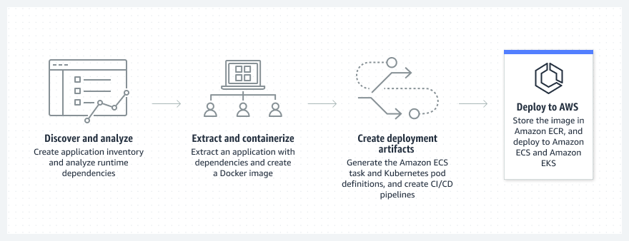
AWS App2Container

Slide 41
Q&A

Slide 42

Resources
https://aws.amazon.com/developer/language/net/
https://github.com/aws/dotnet
https://aws.amazon.com/sdk-for-net/
https://aws.amazon.com/sdk-for-net/
.NET Immersion Day
http://surl.li/hhrey

Slide 43
Thank you!!!
https://github.com/cwoodruff/dotnet-on-AWS-examples

